Slide 1

This course was developed as a part of the VLIR-UOS Cross-Cutting project s:
Statistics: 2011-2016, 2017.
Statistics: 2017.
Statistics for development : 2018-2020.
The >eR-BioStat ITP: 2024-2026.

Slide 2





Applied Generalized Linear Models (GLM) using R (PART 2)
The >eR-Biostat initiative
Making R based education materials in statistics accessible for all
Developed by
Tadesse Awoke (Gondar University), Said Mussa (Mekele University) , Ziv Shkedy (Hasselt University), and Fetene Tekle (J & J)
ER-BioStat
https://github.com/eR-Biostat
Email: erbiostat@gmail.com
@erbiostat

Slide 3
Reference list
Main reference
  Dobson (2002): An introduction to generalized linear models.
Other references:
  McCillagh and Nelder (1983): Generalized linear models (first edition).
  Collet D(1994): Modeling Binary data.
  Lindsey (1997): Applying generalized linear models.

Slide 4
Software
Two main R functions:
  Linear models in R: the lm() function.
  Generalized linear models in R: the glm() function in R.
All R programs for the examples presented in the slides are available online.

Slide 5
Datasets
Data are given as a part of R programs for the course.
External datasets (which are not given as a part of the R code) and used for illustration are available online.

Slide 6
Topics (part 2)
11. Poisson Regression
Beyond Poisson and binomial distributions: models with
different link functions and/or distributions
13. Poisson regression and log linear models
14. Over dispersion

Slide 7
Chapter 11:
Poisson Regression
Donson: chapter 7.
Lindsey: Appendix B.
McCullagh & Nelder: chapter 2.

Slide 8
Count data
Count data:
  counts per unit of time/area/distance, etc
  contingency tables: counts cross-classified by categorical variables
  Covariates: categorical or continuous

Slide 9
Example 1: Stress data
One randomly chosen member from each randomly chosen household in a sample from Oakaland, California, USA was interviewed. In a list of 41 events, respondents were asked to note which had occurred within the last 18 months. The result is given as:
Month | 1 | 2 | 3 | 4 | 5 | 6 | 7 | 8 | 9
Respondents | 15 | 11 | 14 | 17 | 5 | 11 | 10 | 4 | 8
Month | 10 | 11 | 12 | 13 | 14 | 15 | 16 | 17 | 18
Respondents | 10 | 7 | 9 | 11 | 3 | 6 | 1 | 1 | 14

Slide 10
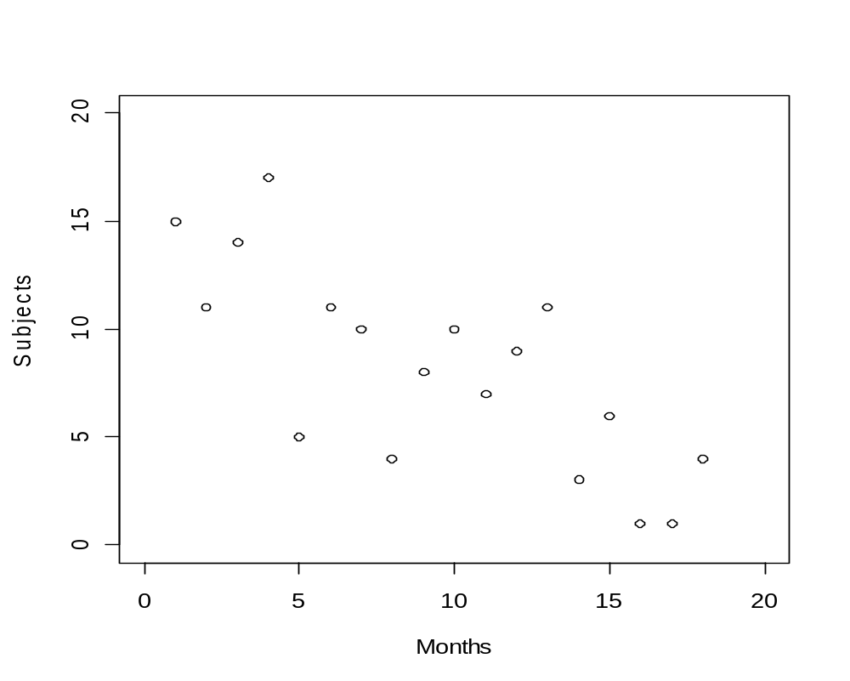
Data in R
> stress <- read.table("C:...../stress.txt", sep=",",header=TRUE)
> attach(stress)
plot(respondents ~ month, xlab = "Months",ylab = "Subjects",
xlim=c(0,20), ylim=c(0,20))

Slide 11
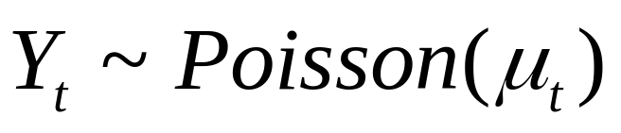
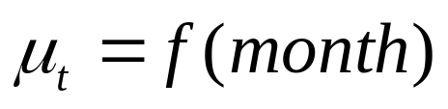
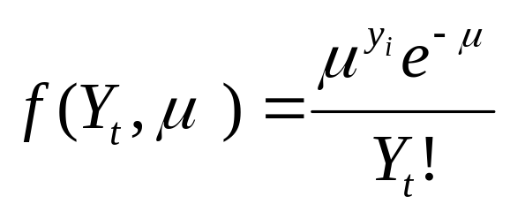
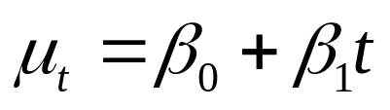
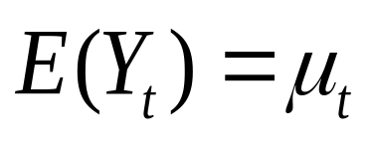
Model formulation
The distribution of the
response variable
The dependency on the predictor
A proposal ?

Slide 12
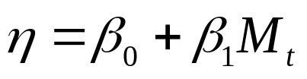
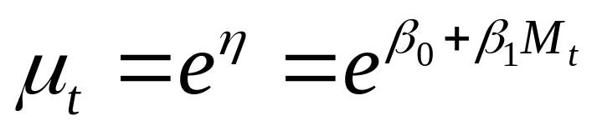
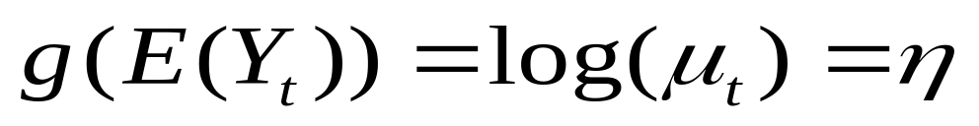
Model formulation
The distribution of the
response variable
The linear predictor

Slide 13

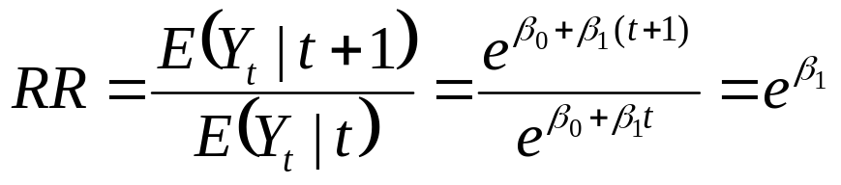
GLM for Poisson regression using glm()
> respGLM <- glm(respondents ~ month,
family=poisson, data=stress)
The relative risk

Slide 14
GLM for Poisson regression using glm()
> summary(respGLM)
Call:
glm(formula = respondents ~ month, family = poisson, data = stress)
Deviance Residuals:
Min 1Q Median 3Q Max
-1.9886 -0.9631 0.1737 0.5131 2.0362
Coefficients:
Estimate Std. Error z value Pr(>|z|)
(Intercept) 2.80316 0.14816 18.920 < 2e-16 ***
month -0.08377 0.01680 -4.986 6.15e-07 ***
---
Signif. codes: 0 ‘***’ 0.001 ‘**’ 0.01 ‘*’ 0.05 ‘.’ 0.1 ‘ ’ 1
(Dispersion parameter for poisson family taken to be 1)
Null deviance: 50.843 on 17 degrees of freedom
Residual deviance: 24.570 on 16 degrees of freedom
AIC: 95.825
Number of Fisher Scoring iterations: 5

Slide 15
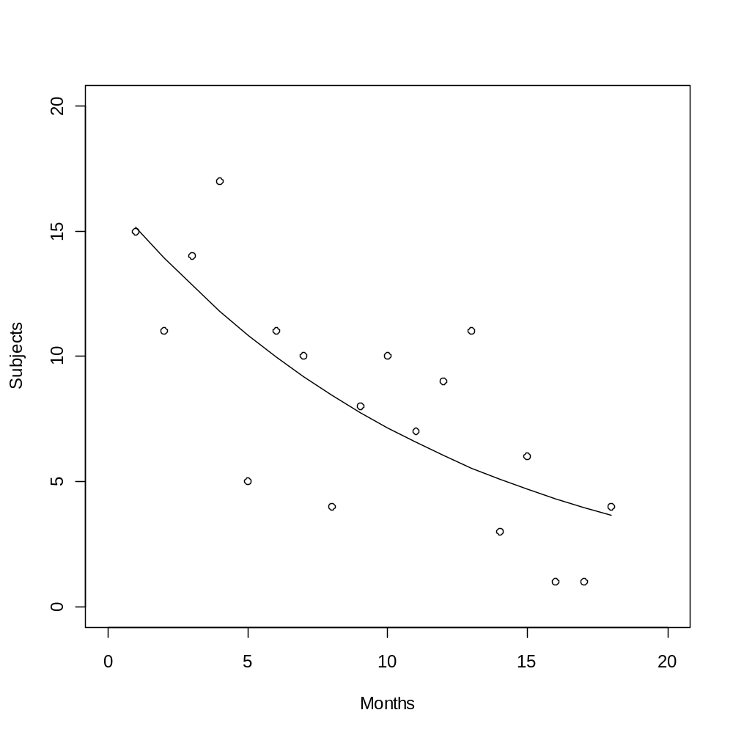
Data and fitted model
plot(respondents ~ month, xlab = "Months",
ylab = "Subjects", xlim=c(0,20), ylim=c(0,20))
lines(month,respGLM$fit)

Slide 16
Example 2: Ministerial resignation
On October 18, 1995, `The Independent' reported on the numbers of ministerial resignations because of different reason. The years start in 1945-1951, with a Labour government, and 7 Resignations.
Main question: Is there any difference between Government (Labor and Conservative) in the rate of resignations?
Term | 45-51 | 51-57 | 55-57 | 57-63 | 63-64 | 64-70 | 70-74 | 74-76 | 76-79 | 79-90 | 90-95 | 97-05
Gov | Lab | con | con | con | con | lab | con | lab | lab | con | con | lab
Res | 7 | 1 | 2 | 7 | 1 | 5 | 6 | 5 | 4 | 1 | 1 | 1
Year | 6 | 4 | 2 | 6 | 1 | 6 | 4 | 2 | 3 | 1 | 5 | 8

Slide 17
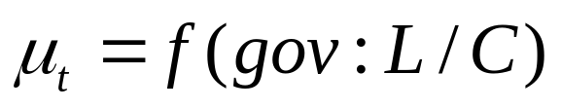
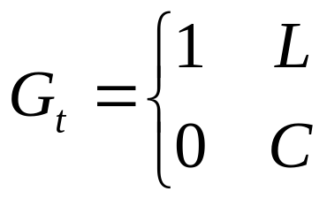
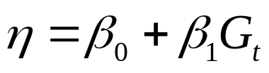
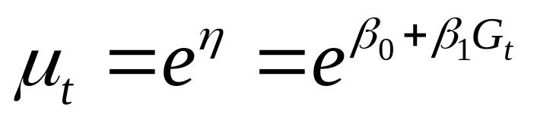
Model formulation
The distribution of the
response variable
The linear predictor

Slide 18
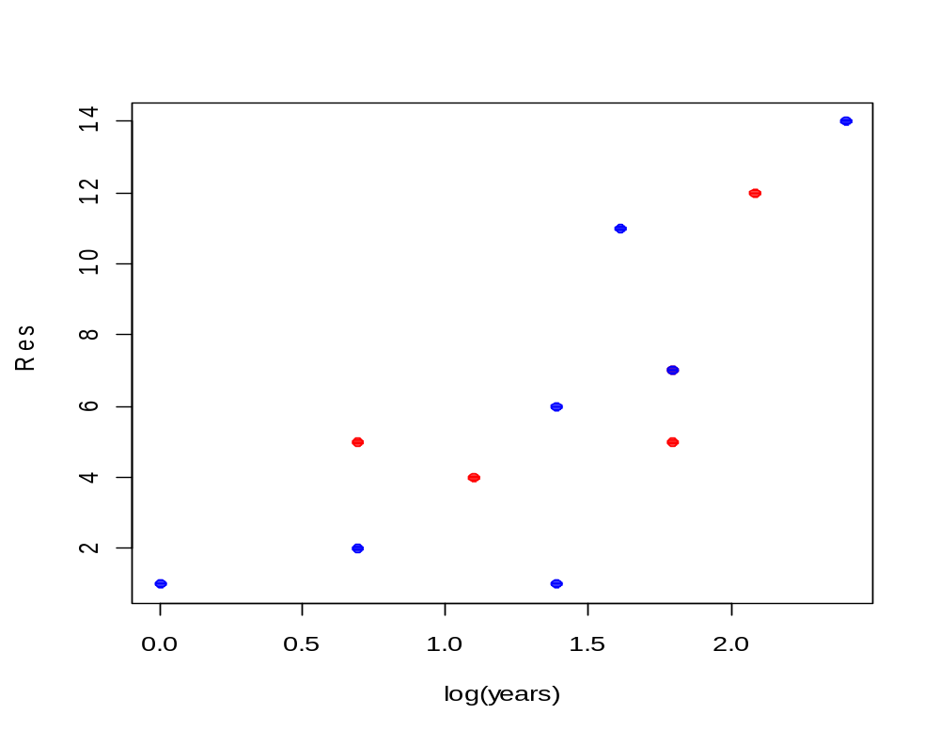
The data in R
>Resignations <- read.table("C:....../resign.txt",header=T)
>attach(Resignations)
>plot(Res ~ log(years), pch=19, col=c(4,2)[Gov])

Slide 19
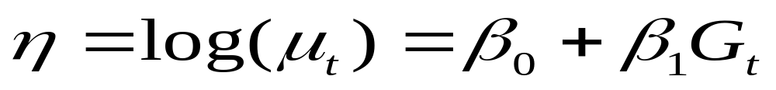
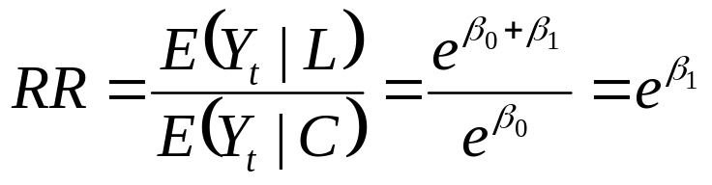
Model formulation (1)
> first.glm <- glm(Res ~ Gov , poisson)
The relative risk

Slide 20
Model 1 output in R
> first.glm <- glm(Res ~ Gov, poisson);
> summary(first.glm)
Call:
glm(formula = Res ~ Gov, family = poisson)
Deviance Residuals:
Min 1Q Median 3Q Max
-2.5331 -1.2942 -0.3255 0.7548 2.7793
Coefficients:
Estimate Std. Error z value Pr(>|z|)
(Intercept) 1.79176 0.15430 11.61 <2e-16 ***
Govlab 0.09531 0.23262 0.41 0.682
---
Signif. codes: 0 ‘***’ 0.001 ‘**’ 0.01 ‘*’ 0.05 ‘.’ 0.1 ‘ ’ 1
(Dispersion parameter for poisson family taken to be 1)
Null deviance: 33.436 on 11 degrees of freedom
Residual deviance: 33.269 on 10 degrees of freedom
AIC: 78.459
Number of Fisher Scoring iterations: 5

Slide 21
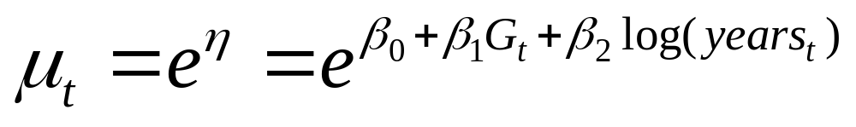
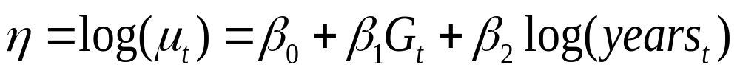
Model formulation (2)
How can we take the number of government years into account ?

Slide 22
GLM with Poisson family
> first.glm <- glm(Res ~ Gov + log(years), poisson)
The same slope for log(year)

Slide 23
Model 2: R output
glm(formula = Res ~ Gov + log(years), family = poisson)
Deviance Residuals:
Min 1Q Median 3Q Max
-2.2417 -0.3469 -0.1250 0.3917 1.6513
Coefficients:
Estimate Std. Error z value Pr(>|z|)
(Intercept) 0.29973 0.41598 0.721 0.471
Govlab 0.03541 0.23271 0.152 0.879
log(years) 0.96636 0.22258 4.342 1.41e-05 ***
---
Signif. codes: 0 ‘***’ 0.001 ‘**’ 0.01 ‘*’ 0.05 ‘.’ 0.1 ‘ ’ 1
(Dispersion parameter for poisson family taken to be 1)
Null deviance: 33.436 on 11 degrees of freedom
Residual deviance: 11.276 on 9 degrees of freedom
AIC: 58.466
Number of Fisher Scoring iterations: 4

Slide 24
Model 3: model formulation
Different intercepts and slopes
> first.glm3 <- glm(Res ~ log(years)+Gov+Gov:log(years),
poisson)

Slide 25
Model 3 output in R
> summary(first.glm)
Call:
glm(formula = Res ~ log(years) +Gov+ Gov:log(years), family= poisson)
Estimate Std. Error z value Pr(>|z|)
(Intercept) 0.04443 0.51085 0.087 0.931
log(years) 1.11144 0.27306 4.070 4.69e-05 ***
Govlab 0.81973 0.82744 0.991 0.322
log(years):Govlab -0.46049 0.46880 -0.982 0.326
Signif. codes: 0 ‘***’ 0.001 ‘**’ 0.01 ‘*’ 0.05 ‘.’ 0.1 ‘ ’ 1
(Dispersion parameter for poisson family taken to be 1)
Null deviance: 33.436 on 11 degrees of freedom
Residual deviance: 10.336 on 8 degrees of freedom
AIC: 59.526
Number of Fisher Scoring iterations: 4

Slide 26
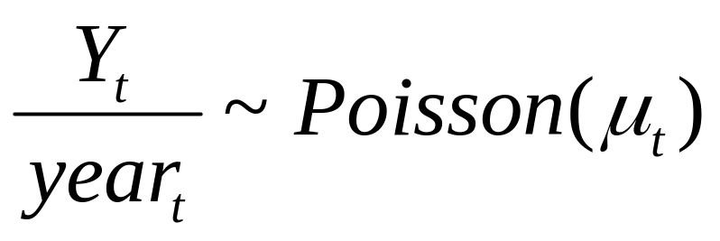
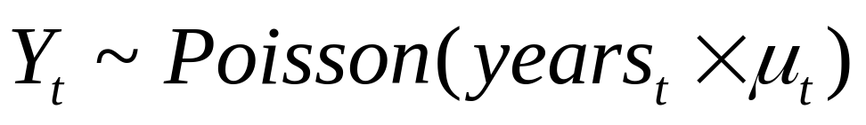
Model 4: GLM with an offset variable: model formulation
Number of resignation per government year:

Slide 27
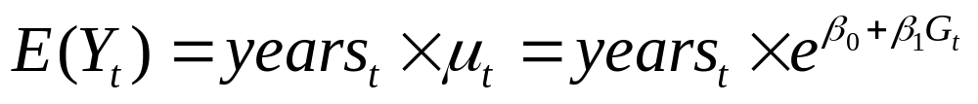
Model 4: GLM with an offset variable - model formulation
offset variable

Slide 28

A model with offset in R
> next.glm<- glm(Res ~ Gov + offset(log(years)), poisson)

Slide 29

Model 4 GLM with offset output in R
summary(first.glm4)
Call:
glm(formula = Res ~ Gov + offset(log(years)), family = poisson)
Estimate Std. Error z value Pr(>|z|)
(Intercept) 0.24116 0.15430 1.563 0.118
Govlab 0.03647 0.23262 0.157 0.875
(Dispersion parameter for poisson family taken to be 1)
Null deviance: 11.323 on 11 degrees of freedom
Residual deviance: 11.299 on 10 degrees of freedom
AIC: 56.488
Number of Fisher Scoring iterations: 4

Slide 30
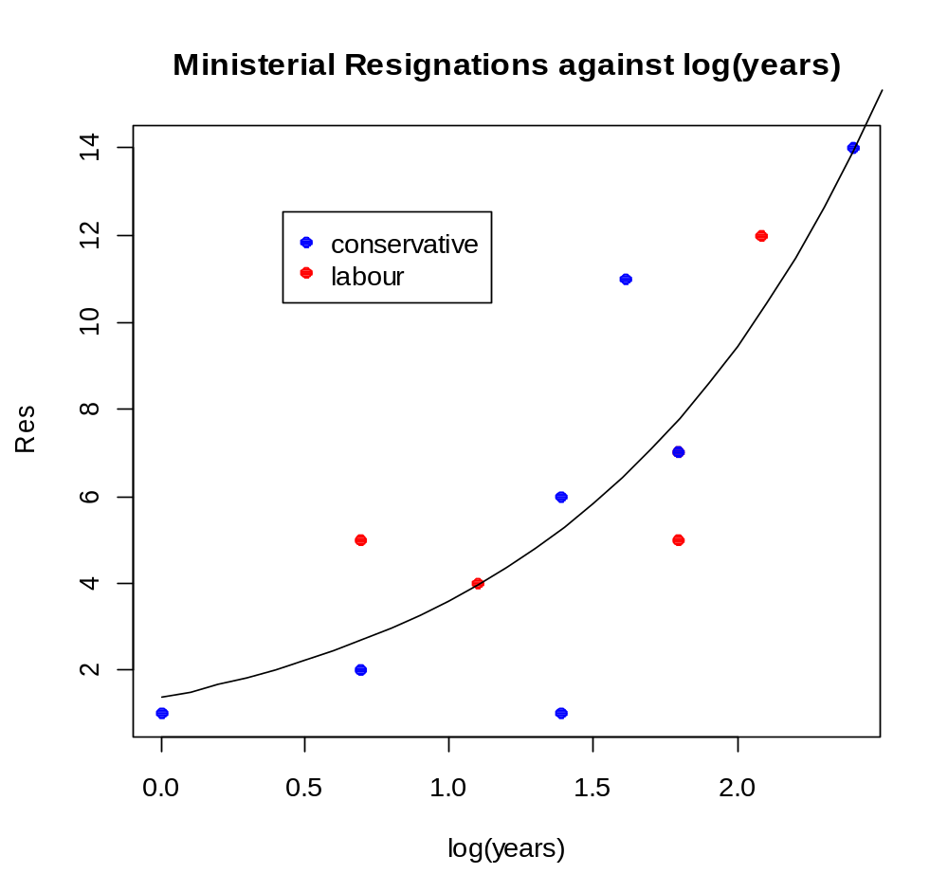
Data and predicted models
plot(Res ~ log(years), pch=19, col=c(4,2)[Gov]) # Use palette() to find out which colour corresponds
> legend(locator(1), legend= c("conservative", "labour"), col=c(4,2), pch=19)
> l <- (0:25)/10
> fv <- exp(0.3168 + 0.9654*l)# to plot fitted curve under last.glm
> lines(l,fv)

Slide 31
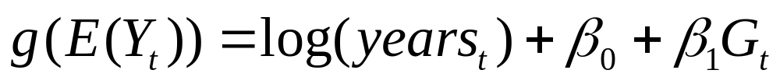
AIC for the different models
MODEL | No parameters | Deviance | AIC
1 | 2 | 33.269 | 78.45861
2 | 3 | 11.276 | 58.46574
3 | 4 | 10.336 | 59.52603
4 | 2 | 11.299 | 56.48846

Slide 32
Confidence interval for β₂ for model 2
first.glm2 <- glm(Res ~ log(years)+Gov, poisson); summary(first.glm)
> confint(first.glm2, level=0.95)
Waiting for profiling to be done...
2.5 % 97.5 %
(Intercept) -0.5701863 1.0636716
log(years) 0.5447242 1.4185361
Govlab -0.4268576 0.4893354

Slide 33
ANOVA for model 3 and model 2
> anova(first.glm3,first.glm2, test = "Chisq")
Analysis of Deviance Table
Model 1: Res ~ log(years) + Gov + Gov:log(years)
Model 2: Res ~ log(years) + Gov
Resid. Df Resid. Dev Df Deviance P(>|Chi|)
1 8 10.336
2 9 11.276 -1 -0.93971 0.3324

Slide 34
Model selection (II): the step() function in R
> step(first.glm, direction = "backward")
Start: AIC=59.53
Res ~ log(years) + Gov + Gov:log(years)
Df Deviance AIC
- log(years):Gov 1 11.276 58.466
<none> 10.336 59.526
Step: AIC=58.47
Res ~ log(years) + Gov
Df Deviance AIC
- Gov 1 11.299 56.489
<none> 11.276 58.466
log(years) 1 33.269 78.459
Step: AIC=56.49
Res ~ log(years)
Df Deviance AIC
<none> 11.299 56.489
log(years) 1 33.436 76.626
Call: glm(formula = Res ~ log(years), family = poisson)
Coefficients:
(Intercept) log(years)
0.3168 0.9654
Degrees of Freedom: 11 Total (i.e. Null); 10 Residual
Null Deviance: 33.44
Residual Deviance: 11.3
AIC: 56.49
Model 4 with the offset variable is not included here.

Slide 35
Example 3: smoking and coronary death
> CHD
age smoke death pop
1 40 s 32 52407
2 50 s 104 43248
3 60 s 206 28612
4 70 s 186 12663
5 80 s 102 5317
6 40 ns 2 18790
7 50 ns 12 10673
8 60 ns 28 5710
9 70 ns 28 2585
10 80 ns 31 1462
A study about tobacco consumption and coronary heart disease among British doctors.

Slide 36
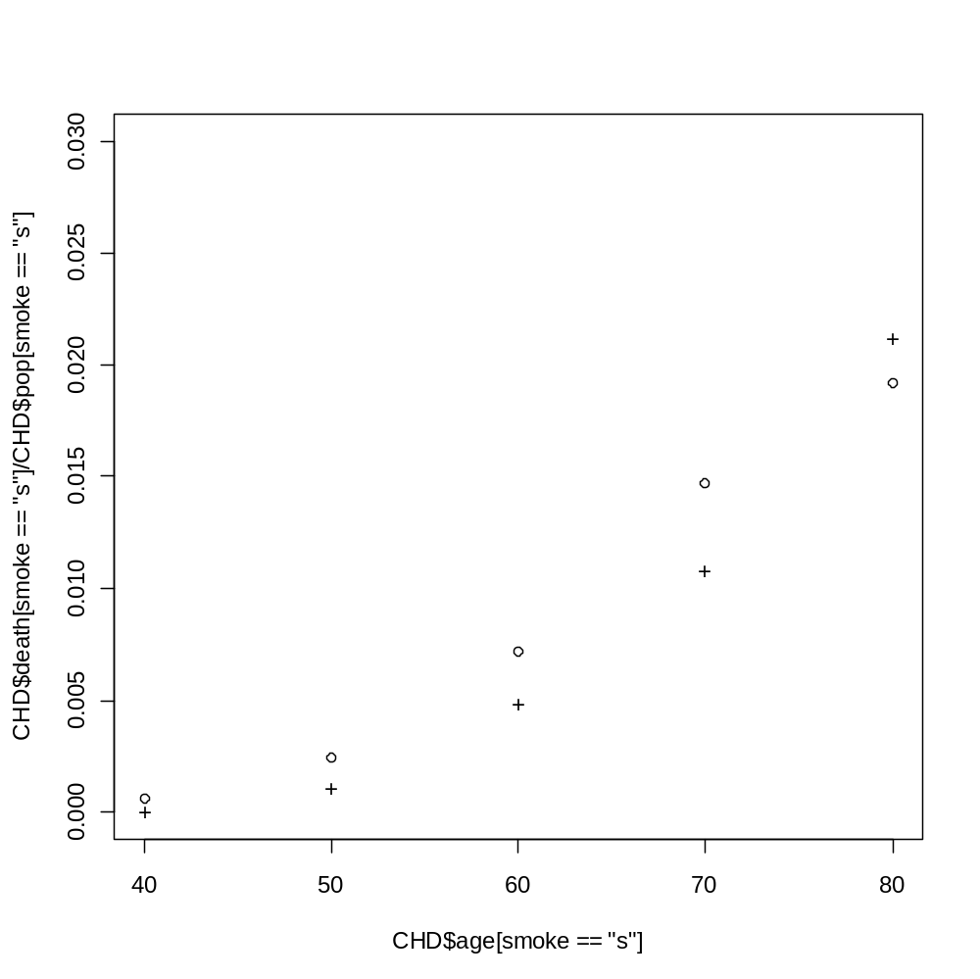
Smoking and coronary death: the data
Proportion of death (from the population)
Age

Slide 37
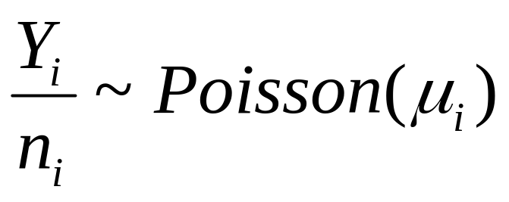
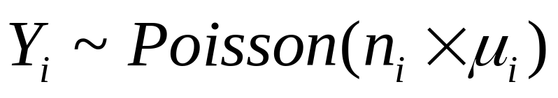
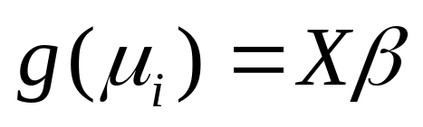
GLM with an offset variable: model formulation
Number of deaths per population size:

Slide 38
Smoking and coronary death
Is the death rate higher for smokers than non smokers ?
If so, by how much ?
Is there differential effects of age ?

Slide 39

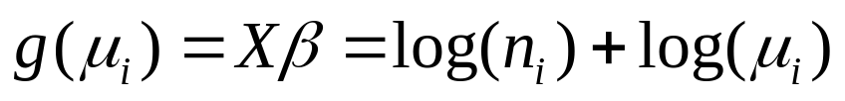

GLM with an offset variable: model formulation
Number of deaths per
population size:
Linear predictor:
Offset variable

Slide 40
3 models
>fit.chd1<-glm(death ~ age + smoke+offset(log(pop)), poisson)
>fit.chd2<-glm(death ~ age + smoke+age:smoke+offset(log(pop)), poisson)
>age2<-age^2
>fit.chd3<-glm(death ~ age+age2+smoke+age:smoke+offset(log(pop)), poisson)

Slide 41
Model selection
> extractAIC(fit.chd1, k=2)
[1] 3.0000 130.2500
> extractAIC(fit.chd2, k=2)
[1] 4.0000 122.9614
> extractAIC(fit.chd3, k=2)
[1] 5.00000 66.70331
The model with quadratic age effect has the best goodness-of-fit.

Slide 42
R output (model 3)
> summary(fit.chd3)
Call:
glm(formula = death ~ age + age2 + smoke + age:smoke + offset(log(pop)),
family = poisson)
Coefficients:
Estimate Std. Error z value Pr(>|z|)
(Intercept) -1.970e+01 1.253e+00 -15.717 < 2e-16 ***
age 3.563e-01 3.632e-02 9.810 < 2e-16 ***
age2 -1.977e-03 2.737e-04 -7.223 5.08e-13 ***
smokes 2.364e+00 6.562e-01 3.602 0.000316 ***
age:smokes -3.075e-02 9.704e-03 -3.169 0.001528 **
---
Signif. codes: 0 ‘***’ 0.001 ‘**’ 0.01 ‘*’ 0.05 ‘.’ 0.1 ‘ ’ 1
(Dispersion parameter for poisson family taken to be 1)
Null deviance: 935.0673 on 9 degrees of freedom
Residual deviance: 1.6354 on 5 degrees of freedom
AIC: 66.703
Number of Fisher Scoring iterations: 4

Slide 43
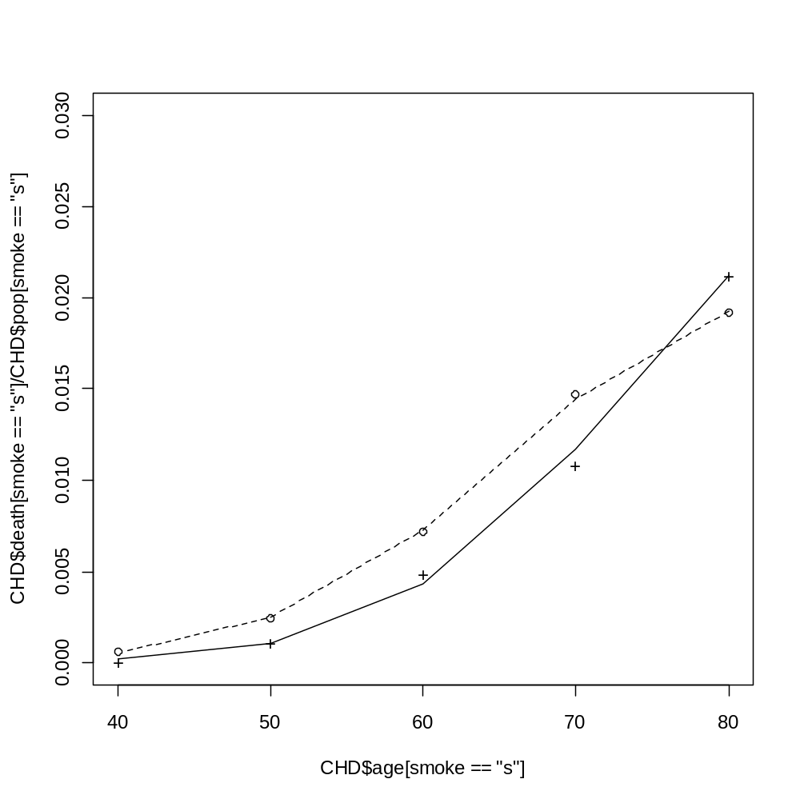

Data and predicted model

Slide 45
Chapter 12:
Beyond Poisson and binomial distributions:
Models with different link functions and/or distributions
Lindsey: Chapter 4.

Slide 46
Example 1: Employment duration
The employment duration of staff, age 25 to 44, recruited to the British post office in the first quarter of 1973 and classified in to two grades.
Month | Grade 1 | Grade2 | Month | Grade1 | Grade2
1 | 22 | 30 | 13 | 0 | 1
2 | 18 | 28 | 14 | 0 | 0
3 | 19 | 31 | 15 | 0 | 0
4 | 13 | 14 | 16 | 1 | 1
5 | 5 | 10 | 17 | 1 | 1
6 | 6 | 6 | 18 | 1 | 0
7 | 3 | 5 | 19 | 3 | 2
8 | 2 | 2 | 20 | 1 | 0
9 | 2 | 3 | 21 | 1 | 3
10 | 1 | 0 | 22 | 0 | 1
11 | 0 | 0 | 23 | 0 | 1
12 | 1 | 1 | 24 | 0 | 0

Slide 47
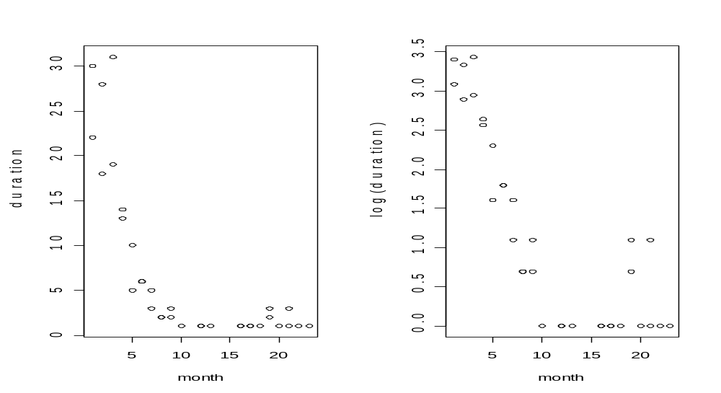
The data in R
> employ <- read.table("C:.... /employ.txt",header=TRUE)
> attach(employ)
> employ
month grade duration
1 1 1 22
2 1 2 30
3 2 1 18
4 2 2 28
5 3 1 19
6 3 2 31
7 4 1 13
8 4 2 14
9 5 1 5
10 5 2 10
. . . .
Original sacle.
log transformation.

Slide 48
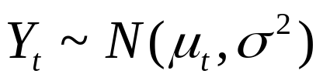

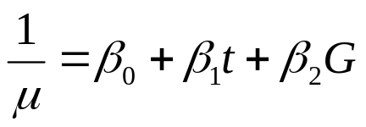


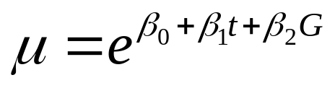
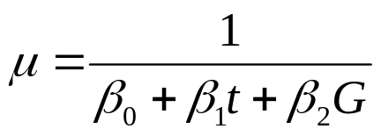
Model formulation
Models with normal error.
identity link
Log link
invesre link

Slide 49
Models with normal error in R
m.normal.idt <- glm(duration ~ month + grade + month:grade,data = employ, family = gaussian(link = identity))
m.normal.inv <- glm(duration ~ month + grade + month:grade,data = employ, family = gaussian(link = inverse))
m.normal.log <- glm(duration ~ month + grade + month:grade,data = employ, family = gaussian(link = log))
m.normal.log1 <- glm(duration ~ month + grade ,data = employ,
family = gaussian(link = log))

Slide 50
Model selection
> extractAIC(m.normal.idt, k=2)
[1] 4.0000 228.5094
> extractAIC(m.normal.inv, k=2)
[1] 4.0000 198.3163
> extractAIC(m.normal.log, k=2)
[1] 4.0000 173.8542
> extractAIC(m.normal.log1, k=2)
[1] 3.0000 171.8545
The model with log link has the smallest AIC value.

Slide 51
GLM with normal error and log link in R
> m.normal.log <- glm(duration ~ month + grade + month:grade,data = employ1, family = gaussian(link = log))
> summary(m.normal.log)
Call:
glm(formula = duration ~ month + grade + month:grade, family = gaussian(link = log),
data = employ1)
Deviance Residuals:
Min 1Q Median 3Q Max
-4.6676 -1.5332 -0.2005 0.8915 10.8676
Coefficients:
Estimate Std. Error t value Pr(>|t|)
(Intercept) 3.4476971 0.1304802 26.423 < 2e-16 ***
month -0.2709521 0.0444746 -6.092 1.08e-06 ***
grade2 0.3698490 0.1591805 2.323 0.0271 *
month:grade2 -0.0007872 0.0545143 -0.014 0.9886
---
Signif. codes: 0 ‘***’ 0.001 ‘**’ 0.01 ‘*’ 0.05 ‘.’ 0.1 ‘ ’ 1
(Dispersion parameter for gaussian family taken to be 8.219982)
Null deviance: 2771.88 on 33 degrees of freedom
Residual deviance: 246.59 on 30 degrees of freedom
AIC: 173.85
Number of Fisher Scoring iterations: 7

Slide 52
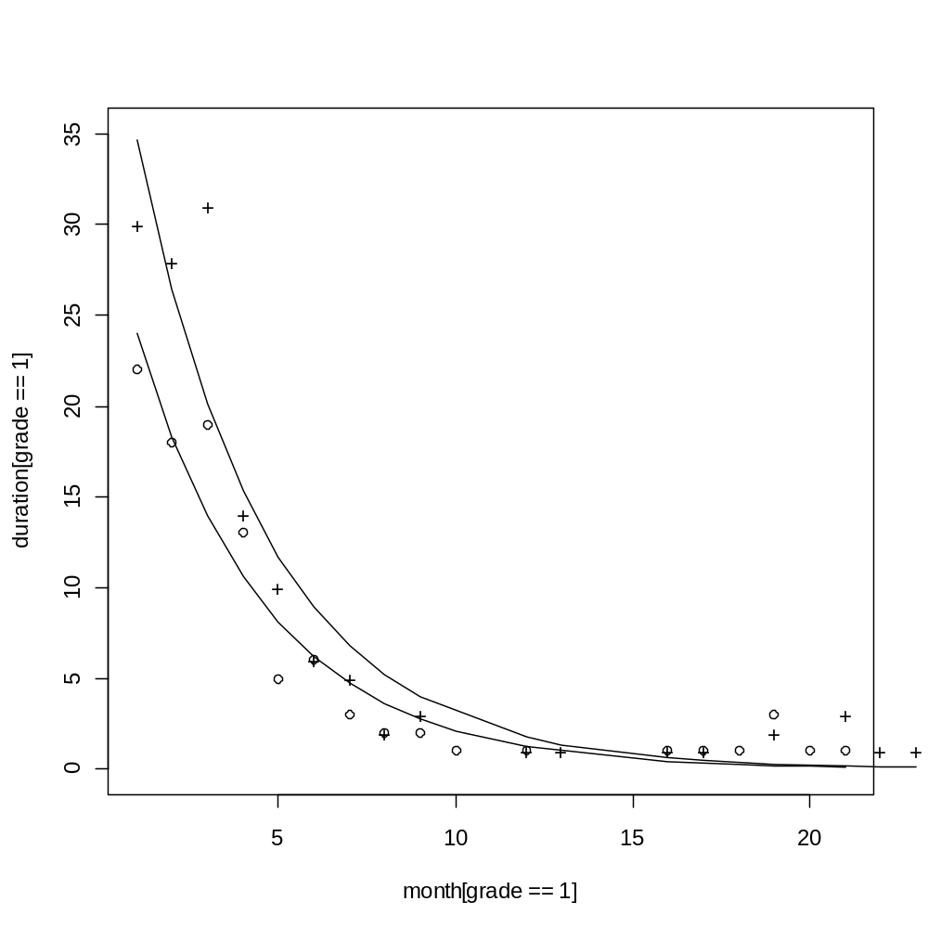
Data and fitted model

Slide 53
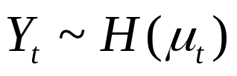

Other models
Different distributions:
  Normal.
  Gamma.
  …
identity link
Log link
invesre link

Slide 54
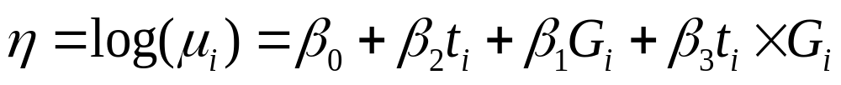
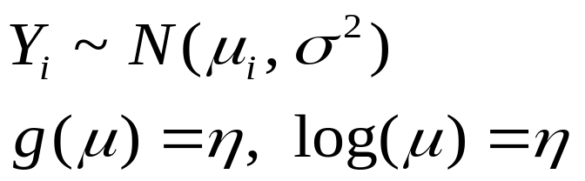
Model formulation (model 1)
m.normal.log <- glm(duration ~ month + grade + month:grade, data = employ1, family = gaussian(link = log))
A model with normal error and log link:

Slide 55
R output : model 1
> m.normal.log <- glm(duration ~ month + grade + month:grade, data = employ, family = gaussian(link = log))
> summary(m.normal.log)
Call:
glm(formula = duration ~ month + grade + month:grade, family = gaussian(link = log),
data = employ)
Deviance Residuals:
Min 1Q Median 3Q Max
-4.6676 -1.5332 -0.2005 0.8915 10.8676
Coefficients:
Estimate Std. Error t value Pr(>|t|)
(Intercept) 3.0778481 0.2764302 11.134 3.54e-12 ***
month -0.2701650 0.0943705 -2.863 0.00759 **
grade 0.3698490 0.1591805 2.323 0.02712 *
month:grade -0.0007872 0.0545143 -0.014 0.98857
---
Signif. codes: 0 ‘***’ 0.001 ‘**’ 0.01 ‘*’ 0.05 ‘.’ 0.1 ‘ ’ 1
(Dispersion parameter for gaussian family taken to be 8.219982)
Null deviance: 2771.88 on 33 degrees of freedom
Residual deviance: 246.59 on 30 degrees of freedom
AIC: 173.85

Slide 56
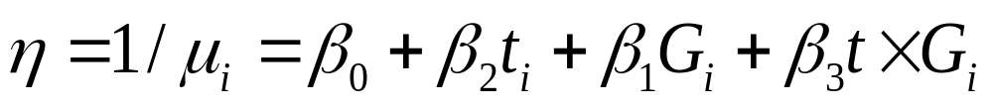
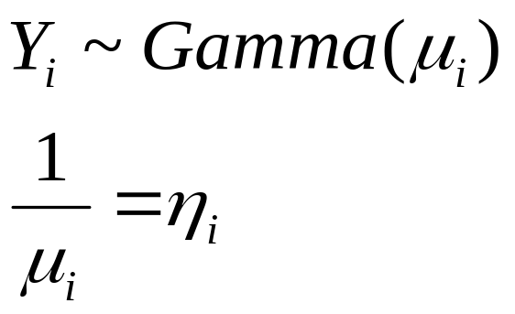
Model with gamma error and inverse link function: model formulation (model 2)
m.gamma.log <- glm(duration ~ month + grade + month:grade,
data = employ1,
family = Gamma(link = inverse))
A model with gamma error and inverse:

Slide 57
R output: model 2
> m.gamma.inv <- glm(duration ~ month + grade + month:grade, data = employ, family = Gamma(link = inverse))
> summary(m.gamma.inv )
Call:
glm(formula = duration ~ month + grade + month:grade, family = Gamma(link = inverse),
data = employ)
Coefficients:
Estimate Std. Error t value Pr(>|t|)
(Intercept) -0.0122937 0.0396403 -0.310 0.75861
month 0.0492390 0.0154143 3.194 0.00329 **
grade -0.0008403 0.0226236 -0.037 0.97062
month:grade -0.0089011 0.0090337 -0.985 0.33235
---
Signif. codes: 0 ‘***’ 0.001 ‘**’ 0.01 ‘*’ 0.05 ‘.’ 0.1 ‘ ’ 1
(Dispersion parameter for Gamma family taken to be 0.3661260)
Null deviance: 51.752 on 33 degrees of freedom
Residual deviance: 9.887 on 30 degrees of freedom
AIC: 147.27

Slide 58
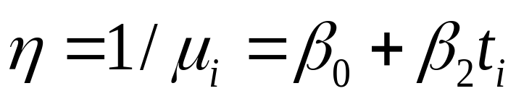
Model with gamma error and inverse link function: model formulation (model 3)
Grade is not included in the model:
A model with gamma error and inverse:

Slide 59
R output: model 3
> m.gamma.inv1 <- glm(duration ~ month , data = employ, family = Gamma(link = inverse))
> summary(m.gamma.inv1)
Call:
glm(formula = duration ~ month, family = Gamma(link = inverse),
data = employ)
Deviance Residuals:
Min 1Q Median 3Q Max
-0.9163 -0.5284 -0.2795 0.2599 1.2685
Coefficients:
Estimate Std. Error t value Pr(>|t|)
(Intercept) -0.014033 0.010821 -1.297 0.204
month 0.035353 0.004445 7.954 4.45e-09 ***
---
Signif. codes: 0 ‘***’ 0.001 ‘**’ 0.01 ‘*’ 0.05 ‘.’ 0.1 ‘ ’ 1
(Dispersion parameter for Gamma family taken to be 0.3762360)
Null deviance: 51.752 on 33 degrees of freedom
Residual deviance: 10.562 on 32 degrees of freedom
AIC: 145.63
Number of Fisher Scoring iterations: 6

Slide 60
Model selection
> AIC(m.normal.log)
[1] 173.8542
> AIC(m.gamma.inv)
[1] 147.2748
> AIC(m.gamma.inv1)
[1] 145.6314
> AIC(m.gamma.inv2)
[1] 145.3437
The model which give small AIC is the gamma model with inverse line and only duration in the model

Slide 61
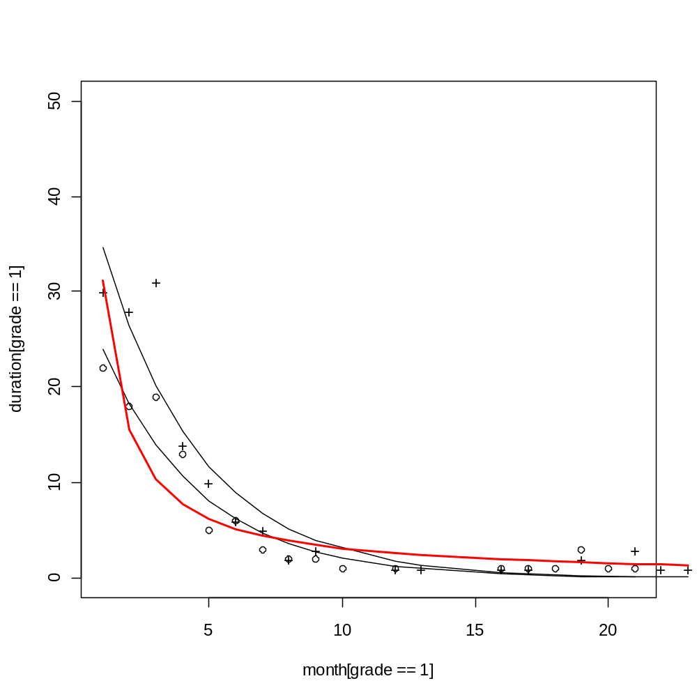
Data and fitted models

Slide 62


Slide 63
Chapter 13:
Poisson regression and log linear models
Based on Dobson: Chapter 9

Slide 64
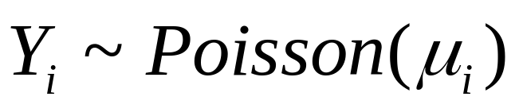
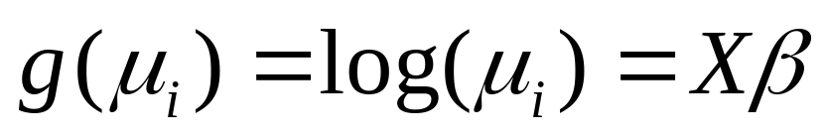
Log linear models
The general frame work of Poisson regression is given by:

Slide 65
Example 1: melanoma
 | Site
Tumor Type | Head & neck | Trunk | Exteremities | total
Hutchinson | 22 | 2 | 10 | 34
Superficial melanoma | 16 | 54 | 115 | 185
Nodular | 19 | 33 | 73 | 125
Indeterminate | 11 | 17 | 28 | 56
Total | 68 | 106 | 226 | 400
Cross sectional study of patients with form of skin cancer.
Different sites & different tumor types.

Slide 66
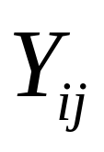
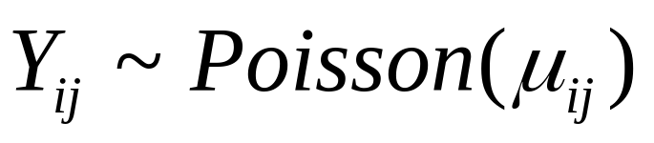

Example 1
 | Site
Tumor Type | Head & neck | Trunk | Exteremities | total
Hutchinson | 22 | 2 | 10 | 34
Superficial melanoma | 16 | 54 | 115 | 185
Nodular | 19 | 33 | 73 | 125
Indeterminate | 11 | 17 | 28 | 56
Total | 68 | 106 | 226 | 400
Frequency of subjects with tumor type i and site j.
Sample size.

Slide 67
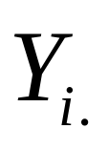
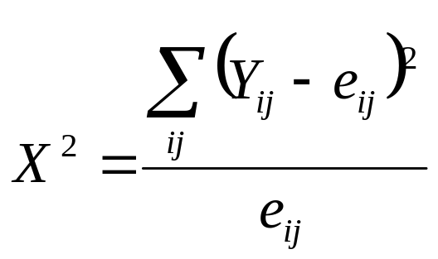



Example 1: independence ?
 | Site
Tumor Type | Head & neck | Trunk | Exteremities | total
Hutchinson | 22 | 2 | 10 | 34
Superficial melanoma | 16 | 54 | 115 | 185
Nodular | 19 | 33 | 73 | 125
Indeterminate | 11 | 17 | 28 | 56
Total | 68 | 106 | 226 | 400
Chi-squared statistic for independence:

Slide 68

Example 1: independence ?

Slide 69



Model formulation
The minimal
model
Independence
model
Second ordered interaction model
M1
M2
M3

Slide 70
Data in R
> melanoma
Tumor Type y
1 Hu HN 22
2 Hu Trunk 2
3 Hu Extrem 10
4 Su HN 16
5 Su Trunk 45
6 Su Extrem 115
7 Nod HN 19
8 Nod Trunk 33
9 Nod Extrem 73
10 Ind HN 11
11 Ind Trunk 17
12 Ind Extrem 28

Slide 71
Models in R
> M1<-glm(y~1, family=poisson, data=melanoma)
> M2<-glm(y~Tumor+Type, family=poisson, data=melanoma)
> M3<-glm(y~Tumor+Type+Tumor:Type,family=poisson,
data=melanoma)
> AIC(M1)
[1] 348.8361
> AIC(M2)
[1] 121.5482
> AIC(M3)
[1] 82.9297

Slide 72
Likelihood ratio test
> anova.glm(M2,M3,test="Chisq")
Analysis of Deviance Table
Model 1: y ~ Tumor + Type
Model 2: y ~ Tumor + Type + Tumor:Type
Resid. Df Resid. Dev Df Deviance P(>|Chi|)
1 6 50.618
2 0 0.000 6 50.618 3.533e-09 ***
---
Signif. codes: 0 ‘***’ 0.001 ‘**’ 0.01 ‘*’ 0.05 ‘.’ 0.1 ‘ ’ 1
>

Slide 73
Example 2: Death penalty
Death penalty verdicts for cases involving multiple murders in Florida between 1976 and 1987. This data is from an article that studied effects of racial characteristics on whether persons convicted of homicide received the death penalty. The 674 subjects classified is in to a 2x2x2 contingency table-two rows, two columns, and two layers.
 |  | Victim’s Race
 |  | White |  | Black
 |  | Defendant’s Race |  | Defendant’s Race
 |  | White | Black | White | Black
Death Penalty | Yes | 53 | 11 | 0 | 4
 | No | 414 | 37 | 16 | 139
Percent Yes |  | 11.3 | 22.9 | 0.0 | 2.8

Slide 74

Example 3: Death penalty
 |  | Victim’s Race
 |  | White |  | Black
 |  | Defendant’s Race |  | Defendant’s Race
 |  | White | Black | White | Black
Death Penalty | Yes | 53 | 11 | 0 | 4
 | No | 414 | 37 | 16 | 139
Percent Yes |  | 11.3 | 22.9 | 0.0 | 2.8
The response variable: death penalty verdicts

Slide 75
Example 3: Death penalty
 |  | Victim’s Race
 |  | White |  | Black
 |  | Defendant’s Race |  | Defendant’s Race
 |  | White | Black | White | Black
Death Penalty | Yes | 53 | 11 | 0 | 4
 | No | 414 | 37 | 16 | 139
The mean structure

Slide 76

Exploring the Data in R
> deathpenalty <- data.frame(number = c(53,11,0,4,414,37,16,139),
+ victim = c("W","W","B","B","W","W","B","B"),
+ defendant = c("W","B","W","B","W","B","W","B"),
+ death = rep(c("yes","no"),rep(4,2)))
plot(xtabs(number~ victim + defendant+ death, deathpenalty))

Slide 77
The model in R
M1<-glm(number~victim*defendant*death,
family=poisson,
data=deathpenalty)

Slide 78
Saturated model with Poisson family
> M1<-glm(number~victim*defendant*death, family=poisson, data=deathpenalty)
> summary(M1)
> Call:
Estimate Std. Error z value Pr(>|z|)
(Intercept) 4.934e+00 8.482e-02 58.177 < 2e-16 ***
victimW -1.324e+00 1.850e-01 -7.155 8.38e-13 ***
defendantW -2.162e+00 2.640e-01 -8.189 2.63e-16 ***
deathyes -3.548e+00 5.071e-01 -6.996 2.63e-12 ***
victimW:defendantW 4.577e+00 3.149e-01 14.536 < 2e-16 ***
victimW:deathyes 2.335e+00 6.125e-01 3.813 0.000137 ***
defendantW:deathyes -2.153e+01 4.225e+04 -0.001 0.999593
victimW:defendantW:deathyes 2.068e+01 4.225e+04 0.00049 0.999609
---
Signif. codes: 0 ‘***’ 0.001 ‘**’ 0.01 ‘*’ 0.05 ‘.’ 0.1 ‘ ’ 1
(Dispersion parameter for poisson family taken to be 1)
Null deviance: 1.2251e+03 on 7 degrees of freedom
Residual deviance: 4.1224e-10 on 0 degrees of freedom
AIC: 54.04
Number of Fisher Scoring iterations: 20

Slide 79
Using the step function in R to identify the best model
step(the three way interaction model)
A stepwise selection based on AIC.
Starting point: the three way interaction model.

Slide 80
Step () function for model selection
> step(M1)
Start: AIC=54.04
number ~ victim * defendant * death
Df Deviance AIC
- victim:defendant:death 1 0.37984 52.42
<none> 0.00000 54.04
Step: AIC=52.42
number ~ victim + defendant + death + victim:defendant + victim:death +
defendant:death
Df Deviance AIC
<none> 0.38 52.42
- defendant:death 1 5.39 55.43
- victim:death 1 20.73 70.77
- victim:defendant 1 384.43 434.47
Starting point (see also slide 79).
Three was interaction is excluded.
Two way interaction are excluded (one at the time).
The best model includes all two way interactions:

Slide 81
Output of the Step() function
Call: glm(formula = number ~ victim + defendant + death + victim:defendant +
victim:death + defendant:death,
family = poisson, data = deathpenalty)
Coefficients:
(Intercept) victimW defendantW
4.9358 -1.3298 -2.1746
deathyes victimW:defendantW victimW:deathyes
-3.5961 4.5950 2.4044
defendantW:deathyes
-0.8678
Degrees of Freedom: 7 Total (i.e. Null); 1 Residual
Null Deviance: 1225
Residual Deviance: 0.3798 AIC: 52.42

Slide 82
The two way interaction model in R
M2<-glm(number~victim+defendant+death
+victim:defendant
+victim:death
+defendant:death,
family=poisson, data=deathpenalty)

Slide 83
Output in R
> summary(M2)
Call:
glm(formula = number ~ victim + defendant + death + victim:defendant +
victim:death + defendant:death, family = poisson, data = deathpenalty)
Coefficients:
Estimate Std. Error z value Pr(>|z|)
(Intercept) 4.93578 0.08471 58.265 < 2e-16 ***
victimW -1.32980 0.18479 -7.196 6.19e-13 ***
defendantW -2.17465 0.26377 -8.245 < 2e-16 ***
deathyes -3.59610 0.50691 -7.094 1.30e-12 ***
victimW:defendantW 4.59497 0.31353 14.656 < 2e-16 ***
victimW:deathyes 2.40444 0.60061 4.003 6.25e-05 ***
defendantW:deathyes -0.86780 0.36707 -2.364 0.0181 *
---
Signif. codes: 0 ‘***’ 0.001 ‘**’ 0.01 ‘*’ 0.05 ‘.’ 0.1 ‘ ’ 1
(Dispersion parameter for poisson family taken to be 1)
Null deviance: 1225.07955 on 7 degrees of freedom
Residual deviance: 0.37984 on 1 degrees of freedom
AIC: 52.42

Slide 84
Example 3: Antibiotic prescription
Diagnosis of Respiratory Tract Infections Hueston and Stott (2000) report a study of clinicians' diagnoses of respiratory tract infections over a 14-month period. The aim was to determine whether a reduction in prescription of antibiotics to acute bronchitis patients was due to clinicians assigning an alternative diagnosis.
 | Time period
Diagnosis | 1-3/96 | 4-6/96 | 7-9/96 | 10-12/96 | 1-2/97
Acute bronchitis | 113 | 58 | 40 | 108 | 100
Acute sinusitis | 99 | 37 | 23 | 50 | 32
URI | 410 | 228 | 125 | 366 | 304
Pneumonia | 60 | 43 | 30 | 56 | 45
Total | 682 | 366 | 218 | 580 | 481

Slide 85
The data in R
> diag <- rep(c("bron", "sinus", "URI", "pneu"), 5)
> time <- rep(c("win96", "spr96", "sum96", "aut96", "spr97"), rep(4, 5))
> rt <- data.frame(diag = factor(diag, unique(diag)),
+ time = factor(time, unique(time)), count = c(113, 99, 410, 60, 58, 37, 228, 43, 40, 23, 125, 30,
+ 108, 50, 366, 56, 100, 32, 304, 45))

Slide 86
Example 3: Antibiotic prescription
Data in R
 | Time period
Diagnosis | 1-3/96 | 4-6/96 | 7-9/96 | 10-12/96 | 1-2/97
Acute bronchitis | 113 | 58 | 40 | 108 | 100
Acute sinusitis | 99 | 37 | 23 | 50 | 32
URI | 410 | 228 | 125 | 366 | 304
Pneumonia | 60 | 43 | 30 | 56 | 45
> rt
diag time count
1 bron win96 113
2 sinus win96 99
3 URI win96 410
4 pneu win96 60
5 bron spr96 58
6 sinus spr96 37
7 URI spr96 228
8 pneu spr96 43
9 bron sum96 40
10 sinus sum96 23
11 URI sum96 125
12 pneu sum96 30
13 bron aut96 108
14 sinus aut96 50
15 URI aut96 366
16 pneu aut96 56
17 bron spr97 100
18 sinus spr97 32
19 URI spr97 304
20 pneu spr97 45
Research question:
Diagnostic and time period are independent ?

Slide 87


Models formulation
Minimal model
Independence
model
Second ordered interaction

Slide 88
Models in R
>
> M1 <- glm(count ~ 1, family=poisson, data=rt)
> M2 <- glm(count ~ diag+time, family=poisson, data=rt)
> M3 <- glm(count ~ diag+time+diag:time,family=poisson, data=rt)
>
>
> AIC(M1)
[1] 1915.304
> AIC(M2)
[1] 169.8704
> AIC(M3)
[1] 164.2791

Slide 89
Likelihood ratio test
> anova.glm(M2,M3,test="Chisq")
Analysis of Deviance Table
Model 1: count ~ diag + time
Model 2: count ~ diag + time + diag:time
Resid. Df Resid. Dev Df Deviance P(>|Chi|)
1 12 29.591
2 0 0.000 12 29.591 0.003216 **
---
Signif. codes: 0 ‘***’ 0.001 ‘**’ 0.01 ‘*’ 0.05 ‘.’ 0.1 ‘ ’ 1
>
Independence model is rejected.

Slide 90
Output model 3
> summary(M3)
Coefficients:
Estimate Std. Error z value Pr(>|z|)
(Intercept) 4.72739 0.09407 50.253 < 2e-16 ***
diagsinus -0.13227 0.13766 -0.961 0.33664
diagURI 1.28877 0.10625 12.130 < 2e-16 ***
diagpneu -0.63304 0.15974 -3.963 7.40e-05 ***
timespr96 -0.66694 0.16153 -4.129 3.64e-05 ***
timesum96 -1.03851 0.18398 -5.645 1.66e-08 ***
timeaut96 -0.04526 0.13457 -0.336 0.73664
timespr97 -0.12222 0.13729 -0.890 0.37336
diagsinus:timespr96 -0.31726 0.25143 -1.262 0.20702
diagURI:timespr96 0.08013 0.18143 0.442 0.65872
diagpneu:timespr96 0.33380 0.25693 1.299 0.19388
diagsinus:timesum96 -0.42112 0.29568 -1.424 0.15438
diagURI:timesum96 -0.14934 0.21045 -0.710 0.47795
diagpneu:timesum96 0.34536 0.28957 1.193 0.23300
diagsinus:timeaut96 -0.63784 0.21957 -2.905 0.00367 **
diagURI:timeaut96 -0.06827 0.15258 -0.447 0.65457
diagpneu:timeaut96 -0.02374 0.22942 -0.103 0.91760
diagsinus:timespr97 -1.00717 0.24536 -4.105 4.05e-05 ***
diagURI:timespr97 -0.17691 0.15677 -1.128 0.25913
diagpneu:timespr97 -0.16546 0.24029 -0.689 0.49107
---
Signif. codes: 0 ‘***’ 0.001 ‘**’ 0.01 ‘*’ 0.05 ‘.’ 0.1 ‘ ’ 1
(Dispersion parameter for poisson family taken to be 1)
Null deviance: 1.7890e+03 on 19 degrees of freedom
Residual deviance: 1.5765e-14 on 0 degrees of freedom
AIC: 164.28
Number of Fisher Scoring iterations: 3

Slide 92
Chapter 14
Over dispersion
Lindsey: Chapter 3

Slide 93

Over dispersion parameter
The general form of exponential family is defined as:
Where Ø is the dispersion parameter.
a(Ø): scale parameter.

Slide 94




Example: normal distribution
The mean and the variance are separated parameters.

Slide 95





Example: Binomial distribution
The variance is a function of the mean.

Slide 96



Poisson distribution
E(y)=V(y).

Slide 97





Overdispersion
The binomial and Poisson distribution are a members of one parameter exponential family.

Slide 98





Overdispersion
Often, we observed extra variability than expected:
No problem with overdispersion

Slide 99

Estimating over dispersion
Formula

Slide 100
Example 1: Germination of seeds from Orobanche
o. aegyptiaco 75 |  |  |  | o. aegyptiaco 73
bean |  | cucumber |  | bean |  | cucumber
germ. | total | germ. | total | germ. | total | germ. | total
10 | 39 | 5 | 6 | 8 | 16 | 3 | 12
23 | 62 | 53 | 74 | 10 | 30 | 22 | 41
23 | 81 | 55 | 72 | 8 | 28 | 15 | 30
26 | 51 | 32 | 51 | 23 | 45 | 32 | 51
17 | 39 | 46 | 79 | 0 | 4 | 3 | 7
 |  | 10 | 13

Slide 101
Data in R
> fac<-read.table("C:....../seed.txt", header = TRUE)
> fact <- transform(fac, prop = germ/total, extr.seed = interaction(extract,seed))
fact
seed extract germ total prop extr.seed
1 aeg75 bean 10 39 0.2564103 bean.aeg75
2 aeg75 bean 23 62 0.3709677 bean.aeg75
3 aeg75 bean 23 81 0.2839506 bean.aeg75
4 aeg75 bean 26 51 0.5098039 bean.aeg75
5 aeg75 bean 17 39 0.4358974 bean.aeg75
6 aeg75 cucumber 5 6 0.8333333 cucumber.aeg75
7 aeg75 cucumber 53 74 0.7162162 cucumber.aeg75
8 aeg75 cucumber 55 72 0.7638889 cucumber.aeg75
9 aeg75 cucumber 32 51 0.6274510 cucumber.aeg75
10 aeg75 cucumber 46 79 0.5822785 cucumber.aeg75
11 aeg75 cucumber 10 13 0.7692308 cucumber.aeg75
12 aeg73 bean 8 16 0.5000000 bean.aeg73
13 aeg73 bean 10 30 0.3333333 bean.aeg73
14 aeg73 bean 8 28 0.2857143 bean.aeg73
15 aeg73 bean 23 45 0.5111111 bean.aeg73
16 aeg73 bean 0 4 0.0000000 bean.aeg73
17 aeg73 cucumber 3 12 0.2500000 cucumber.aeg73
18 aeg73 cucumber 22 41 0.5365854 cucumber.aeg73
19 aeg73 cucumber 15 30 0.5000000 cucumber.aeg73
20 aeg73 cucumber 32 51 0.6274510 cucumber.aeg73
21 aeg73 cucumber 3 7 0.4285714 cucumber.aeg73

Slide 102

Exploring the data: Box-Plot
> plot(prop ~ extr.seed, data = fact, las = 1, ylab = "proportion")
> points(prop ~ extr.seed, data = fact, pch = 16)
> title("proportion of germinating seeds")

Slide 103

Model 1 formulation
Binomial model

Slide 104
Model 1: binomial family
> g <- glm(cbind(germ, total - germ) ~ extract + seed + extract:seed, family = binomial, data = fact)
> r.pears<-residuals(g, type="pearson")
> summary(g)
The assumption here is over dispersion parameter is Φ=1

Slide 105
Model 1 output
Call:
glm(formula = cbind(germ, total - germ) ~ extract + seed + extract:seed,
family = binomial, data = fact)
Deviance Residuals:
Min 1Q Median 3Q Max
-2.01617 -1.24398 0.05995 0.84695 2.12123
Coefficients:
Estimate Std. Error z value Pr(>|z|)
(Intercept) -0.4122 0.1842 -2.238 0.0252 *
extractcucumber 0.5401 0.2498 2.162 0.0306 *
seedaeg75 -0.1459 0.2232 -0.654 0.5132
extractcucumber:seedaeg75 0.7781 0.3064 2.539 0.0111 *
---
Signif. codes: 0 ‘***’ 0.001 ‘**’ 0.01 ‘*’ 0.05 ‘.’ 0.1 ‘ ’ 1
(Dispersion parameter for binomial family taken to be 1)
Null deviance: 98.719 on 20 degrees of freedom
Residual deviance: 33.278 on 17 degrees of freedom
AIC: 117.87
Number of Fisher Scoring iterations: 4

Slide 106
Estimating over dispersion in R
> X2 <- sum(residuals(g, type = "pearson")^2)
> X2
[1] 31.65114
> phi <- X2/g$df.residual
> phi
[1] 1.861832
> phi <- g$deviance/g$df.residual
> phi
[1] 1.957517
As we can see from the R output, the over dispersion parameter is greater than 1 and hence this is an indication of the presence of over dispersion

Slide 107
Confidence interval for model 1
> g <- glm(cbind(germ, total - germ) ~ extract + seed + extract:seed, family = binomial, data = fact)
> confint(g)
Waiting for profiling to be done...
2.5 % 97.5 %
(Intercept) -0.77866159 -0.05469853
extractcucumber 0.05275108 1.03329024
seedaeg75 -0.58184899 0.29428969
extractcucumber:seedaeg75 0.17619697 1.37823747

Slide 108
Taking into account overdispersion in R
glm(model, family = quasibinomial,...)

Slide 109
Output quasi-binomial model 2
> g.over <- glm(cbind(germ, total - germ) ~ extract + seed + extract:seed, family = quasibinomial, data = fact)
> summary(g.over)
Call:
glm(formula = cbind(germ, total - germ) ~ extract + seed + extract:seed,
family = quasibinomial, data = fact)
Deviance Residuals:
Min 1Q Median 3Q Max
-2.01617 -1.24398 0.05995 0.84695 2.12123
Coefficients:
Estimate Std. Error t value Pr(>|t|)
(Intercept) -0.4122 0.2513 -1.640 0.1193
extractcucumber 0.5401 0.3409 1.584 0.1315
seedaeg75 -0.1459 0.3045 -0.479 0.6379
extractcucumber:seedaeg75 0.7781 0.4181 1.861 0.0801 .
---
Signif. codes: 0 ‘***’ 0.001 ‘**’ 0.01 ‘*’ 0.05 ‘.’ 0.1 ‘ ’ 1
(Dispersion parameter for quasibinomial family taken to be 1.861832)
Null deviance: 98.719 on 20 degrees of freedom
Residual deviance: 33.278 on 17 degrees of freedom
AIC: NA
Number of Fisher Scoring iterations: 4
> summary(g.over)$dispersion
[1] 1.861832

Slide 110
Confidence Interval model2
> library(MASS)
> fact$prop <- with(fact, germ/total)
> g.over.alt <- glm(prop ~ extract + seed + extract:seed,
+ weights = total, family = quasibinomial, data = fact)
> confint(g.over.alt)
Waiting for profiling to be done...
2.5 % 97.5 %
(Intercept) -0.91562380 0.07457178
extractcucumber -0.12415989 1.21529201
seedaeg75 -0.74043242 0.45663323
extractcucumber:seedaeg75 -0.04413964 1.59702376

Slide 111



Estimates and CI for proportion with and without over dispersion
 |  | 2.5% | 97.5%
 | 0.36 | 0.31 | 0.42
 | 0.36 | 0.28 | 0.45
To calculate this you need to install the R packages:
library(doBy)
library(R2HTML)

Slide 112
Example 2: Habitat preferences of lizards
A study consists of two lizards type: Grohami and Opalinus.
Response: number of sites (from the total) occupied by Grahami lizards.
Covariates:
Height of the site (H).
Diameter (D).
Sun condition of the site (S, sun/ shade).
Time of the day (T).

Slide 113
Habitat preferences of lizards
> habitat
G Total S D H T
1 20 22 S1 D1 H1 Early
2 8 9 S1 D1 H1 Mid
3 4 8 S1 D1 H1 Late
4 13 13 S1 D1 H2 Early
5 8 8 S1 D1 H2 Mid
6 12 12 S1 D1 H2 Late
7 8 11 S1 D2 H1 Early
8 4 5 S1 D2 H1 Mid
9 5 8 S1 D2 H1 Late
10 6 6 S1 D2 H2 Early
11 0 0 S1 D2 H2 Mid
12 1 2 S1 D2 H2 Late
13 34 45 S2 D1 H1 Early
14 69 89 S2 D1 H1 Mid
15 18 28 S2 D1 H1 Late
16 31 36 S2 D1 H2 Early
17 55 59 S2 D1 H2 Mid
18 13 16 S2 D1 H2 Late
19 17 32 S2 D2 H1 Early
20 60 92 S2 D2 H1 Mid
21 8 16 S2 D2 H1 Late
22 12 13 S2 D2 H2 Early
23 21 26 S2 D2 H2 Mid
24 4 8 S2 D2 H2 Late
S: sun conditions sun / shade).
D: diameter (<2 / > 2).
H: hight (< 5 / > 5).
T: time of day (early/ mid day/late).

Slide 114



Habitat preferences of lizards: model formulation
Total ample size.
Number of sites occupied by Grahami lizards.
The probability that a site is occupied by Grahami lizards.

Slide 115

Habitat preferences of lizards: model formulation in R
Main effects model in R
> f1<-glm((G/Total)~H+D+S+T,family="binomial",data=habitat)

Slide 116
R output
> summary(f1)
Call:
glm(formula = (G/Total) ~ H + D + S + T, family = "binomial",
data = habitat)
Deviance Residuals:
Min 1Q Median 3Q Max
-0.50878 -0.11019 0.02009 0.26466 0.52322
Coefficients:
Estimate Std. Error z value Pr(>|z|)
(Intercept) 2.0618 1.4060 1.466 0.143
HH2 1.0631 1.1222 0.947 0.343
DD2 -0.8798 1.0841 -0.812 0.417
SS2 -0.6415 1.0884 -0.589 0.556
TLate -1.2054 1.2761 -0.945 0.345
TMid 0.0587 1.4590 0.040 0.968
(Dispersion parameter for binomial family taken to be 1)
Null deviance: 4.6730 on 22 degrees of freedom
Residual deviance: 1.5417 on 17 degrees of freedom
(1 observation deleted due to missingness)
AIC: 28.658

Slide 117
Interpretation
Coefficients:
Estimate Std. Error z value Pr(>|z|)
(Intercept) 2.0618 1.4060 1.466 0.143
HH2 1.0631 1.1222 0.947 0.343
DD2 -0.8798 1.0841 -0.812 0.417
SS2 -0.6415 1.0884 -0.589 0.556
TLate -1.2054 1.2761 -0.945 0.345
TMid 0.0587 1.4590 0.040 0.968
All the parameters estimates are not significant.

Slide 118


diagnostic
>r.pearson<-resid(f1, type="pearson”)
> par(mfrow=c(1,1))
> qqnorm(r.pearson)
> abline(0,1)

Slide 119

diagnostic
> mean(r.pearson)
[1] 0.01454735
> var(r.pearson)
[1] 0.05871372
>r.s<-(r.pearson-mean(r.pearson))/
sqrt((var(r.pearson)))
> qqnorm(r.s)
> abline(0,1)
The variance of pearson residual is much smaller than 1

Slide 120
Taking into account overdispersion
glm((G/Total)~H+D+S+T,family="binomial",data=habitat)
glm((G/Total)~H+D+S+T,family=quasibinomial,data= habitat)

Slide 121
Taking into account overdispersion
> f1.over <- glm((G/Total)~H+D+S+T,family=quasibinomial,data= habitat)
> summary(f1.over)
Call:
glm(formula = (G/Total) ~ H + D + S + T, family = quasibinomial,
data = habitat)
Deviance Residuals:
Min 1Q Median 3Q Max
-0.50878 -0.11019 0.02009 0.26466 0.52322
Coefficients:
Estimate Std. Error t value Pr(>|t|)
(Intercept) 2.0618 0.3883 5.310 5.76e-05 ***
HH2 1.0631 0.3099 3.430 0.00319 **
DD2 -0.8798 0.2994 -2.939 0.00918 **
SS2 -0.6415 0.3006 -2.134 0.04768 *
TLate -1.2054 0.3524 -3.420 0.00326 **
TMid 0.0587 0.4029 0.146 0.88588
---
Signif. codes: 0 ‘***’ 0.001 ‘**’ 0.01 ‘*’ 0.05 ‘.’ 0.1 ‘ ’ 1
(Dispersion parameter for quasibinomial family taken to be 0.07626879)
Null deviance: 4.6730 on 22 degrees of freedom
Residual deviance: 1.5417 on 17 degrees of freedom
(1 observation deleted due to missingness)
AIC: NA
Number of Fisher Scoring iterations: 5

Slide 122
Diagnostic
> mean(r.pearson)
[1] 0.01454735
> var(r.pearson)
[1] 0.05871372
>r.s<-(r.pearson-mean(r.pearson))/
sqrt((var(r.pearson)))
> qqnorm(r.s)
> abline(0,1)
The variance of pearson residual is much smaller than 1
> summary(f1.over)$dispersion
[1] 0.07626879

Slide 123
Example 3: ship damage
The ships data from the MASS package concern a type of damage caused by waves to the forward section of cargo-carrying vessels.
The variables are
  incidents number of damage incidents
  service aggregate months of service
  period period of operation : 1960-74, 75-79
  year year of construction: 1960-64, 65-69, 70-74, 75-79
  type type: '"A"' to '"E"'
Here it makes sense to model the expected number of incidents per aggregate months of service.

Slide 124
Data in R
The data is available in the R the MASS library as:
> library(MASS)
> data(ships)
> ships2 <- subset(ships, service > 0)
> ships2$year <- as.factor(ships2$year)
ships2$period <- as.factor(ships2$period)
> ships
type year period service incidents
1 A 60 60 127 0
2 A 60 75 63 0
3 A 65 60 1095 3
4 A 65 75 1095 4
A 70 60 1512 6
. . . . . .
37 E 70 60 1157 5
38 E 70 75 2161 12
39 E 75 60 0 0
40 E 75 75 542 1

Slide 125


Mean structure and model formulation in R
Model formulation:
offset
Model formulation in R:
> glm1 <- glm(formula = incidents ~ type + year + period,
+ family = poisson(link = "log"), data = ships2,
+ offset = log(service))

Slide 126
R output
> glm1 <- glm(formula = incidents ~ type + year + period,
+ family = poisson(link = "log"), data = ships2,
+ offset = log(service))
> summary(glm1)
Call:
glm(formula = incidents ~ type + year + period, family = poisson(link = "log"),
data = ships2, offset = log(service))
Deviance Residuals:
Min 1Q Median 3Q Max
-1.6768 -0.8293 -0.4370 0.5058 2.7912
Coefficients:
Estimate Std. Error z value Pr(>|z|)
(Intercept) -6.40590 0.21744 -29.460 < 2e-16 ***
typeB -0.54334 0.17759 -3.060 0.00222 **
typeC -0.68740 0.32904 -2.089 0.03670 *
typeD -0.07596 0.29058 -0.261 0.79377
typeE 0.32558 0.23588 1.380 0.16750
year65 0.69714 0.14964 4.659 3.18e-06 ***
year70 0.81843 0.16977 4.821 1.43e-06 ***
year75 0.45343 0.23317 1.945 0.05182 .
period75 0.38447 0.11827 3.251 0.00115 **
---
Signif. codes: 0 ‘***’ 0.001 ‘**’ 0.01 ‘*’ 0.05 ‘.’ 0.1 ‘ ’ 1
(Dispersion parameter for poisson family taken to be 1)
Null deviance: 146.328 on 33 degrees of freedom
Residual deviance: 38.695 on 25 degrees of freedom
AIC: 154.56
Number of Fisher Scoring iterations: 5

Slide 127

Model 1: quasi-poisson log linear
> glm2 <- update(glm1, family = quasipoisson(link = "log"))
> summary(glm2)
> Call:
glm(formula = incidents ~ type + year + period, family = quasipoisson(link = "log"),
data = ships2, offset = log(service))
Coefficients:
Estimate Std. Error t value Pr(>|t|)
(Intercept) -6.40590 0.28276 -22.655 < 2e-16 ***
typeB -0.54334 0.23094 -2.353 0.02681 *
typeC -0.68740 0.42789 -1.607 0.12072
typeD -0.07596 0.37787 -0.201 0.84230
typeE 0.32558 0.30674 1.061 0.29864
year65 0.69714 0.19459 3.583 0.00143 **
year70 0.81843 0.22077 3.707 0.00105 **
year75 0.45343 0.30321 1.495 0.14733
period75 0.38447 0.15380 2.500 0.01935 *
---
Signif. codes: 0 ‘***’ 0.001 ‘**’ 0.01 ‘*’ 0.05 ‘.’ 0.1 ‘ ’ 1
(Dispersion parameter for quasipoisson family taken to be 1.691028)
Null deviance: 146.328 on 33 degrees of freedom
Residual deviance: 38.695 on 25 degrees of freedom
AIC: NA
Number of Fisher Scoring iterations: 5
Standard errors are changed since Φ>1.

Slide 128
Estimation of over dispersion parameter
> X2 <- sum(residuals(glm2, type = "pearson")^2)
> X2
[1] 42.27525
> phi <- X2/glm2$df.residual
> phi
[1] 1.69101
> phi <- g$deviance/glm2$df.residual
> phi
[1] 1.331111

Slide 129
CI for the parameters
> confint(glm2)
2.5 % 97.5 %
(Intercept) -6.9789252 -5.86832189
typeB -0.9793495 -0.07040017
typeC -1.6043341 0.09972077
typeD -0.8628299 0.63543426
typeE -0.2880598 0.92322467
year65 0.3217115 1.08674462
year70 0.3882167 1.25564720
year75 -0.1562814 1.03712256
period75 0.0841713 0.68792187

Slide 130


Summary
ANOVA table without and with assuming over dispersion
Effect | DF
 |  | P(>|χ²|) | P(>F)
Type | 4 | 2.63E-11 | 2.29E-04
Period | 1 | 1.1E-03 | 1.888E-02
Year | 3 | 5.038e-09 | 5.777E-04

